Slide 1


Slide 2





GROUP - C
Raja Chilakamarthy
Songsong Li
Sree Charan Choppara
Ankita Sinha

Slide 3


Slide 4
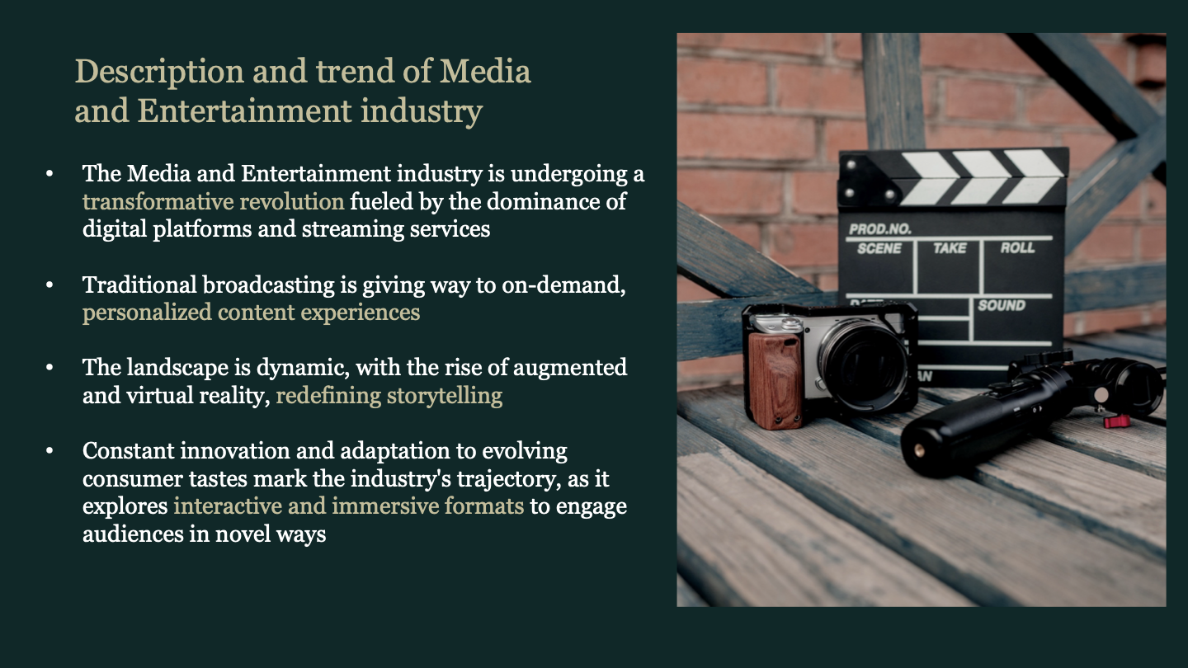

Slide 5
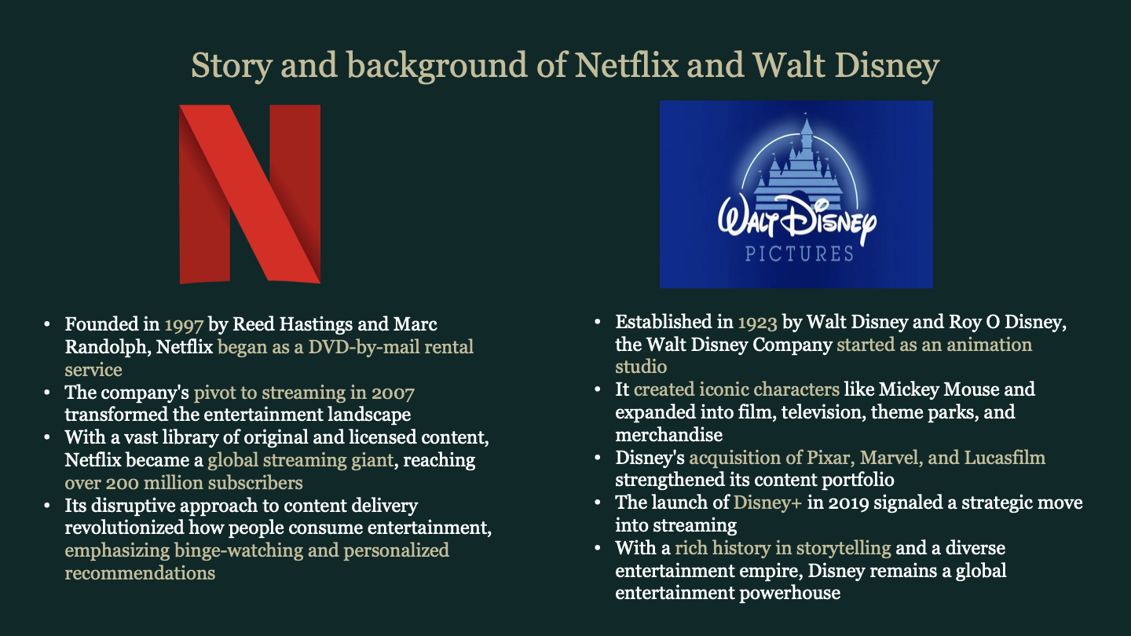

Slide 6
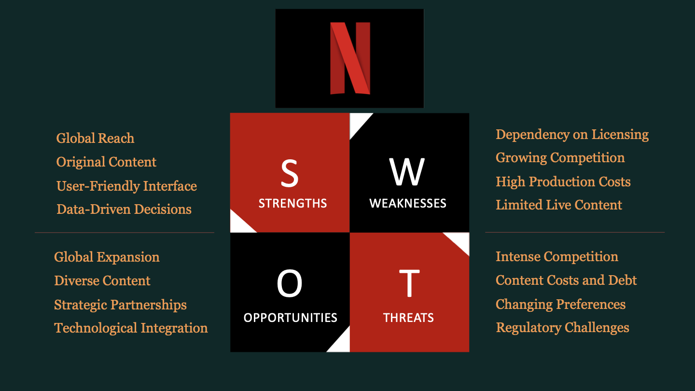

Slide 7
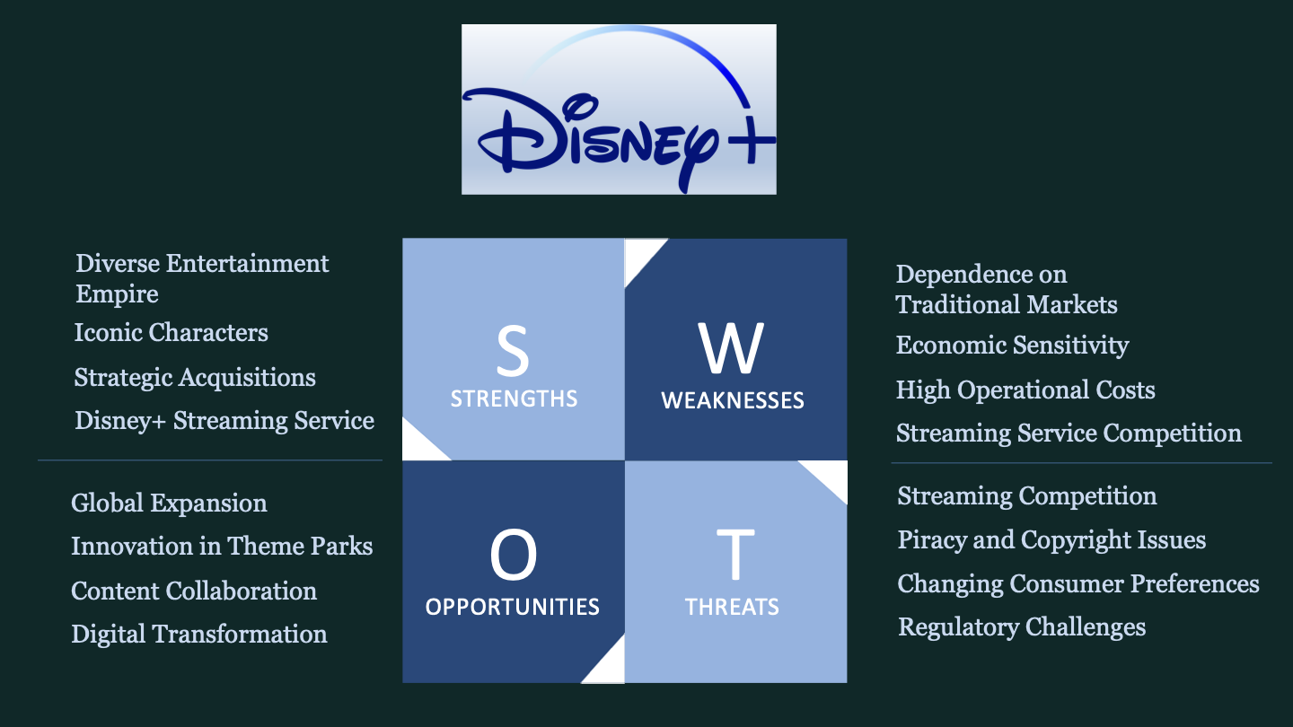

Slide 8
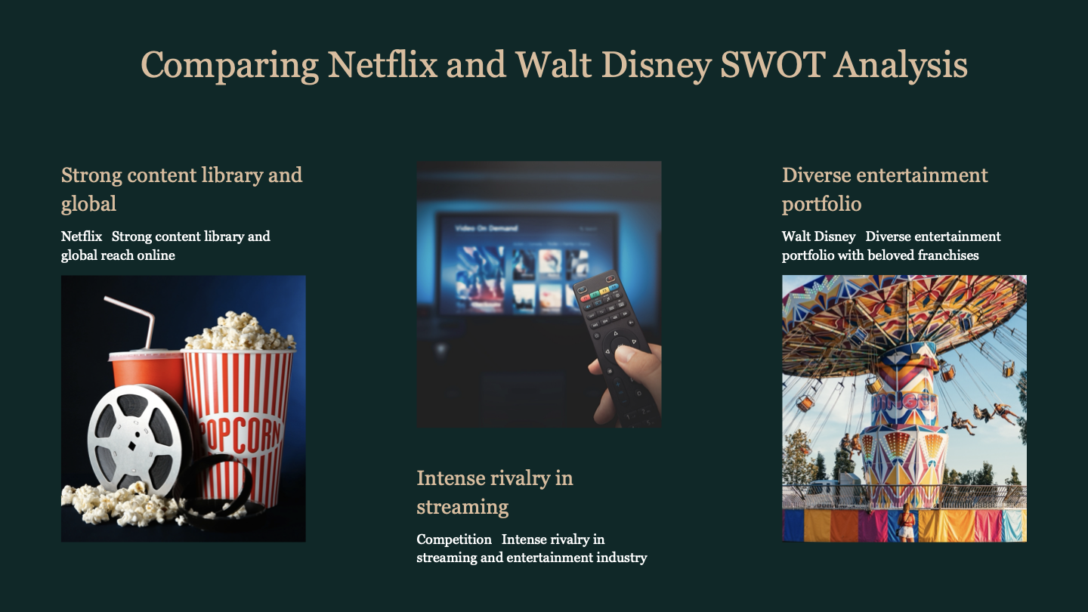

Slide 9


Slide 10
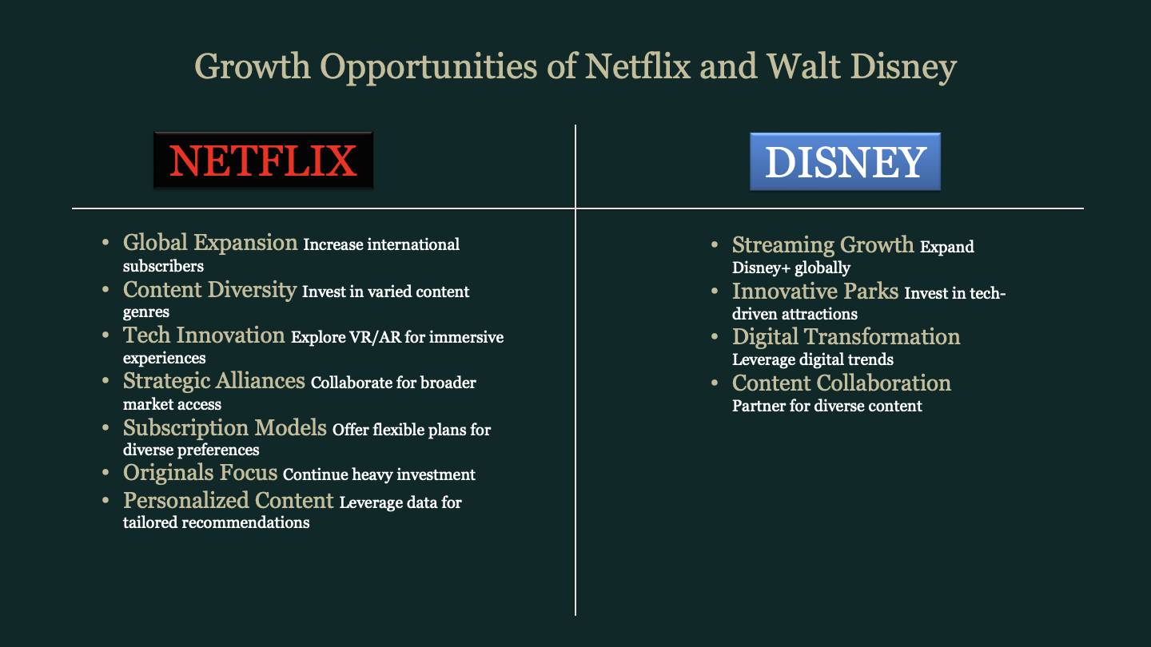

Slide 11
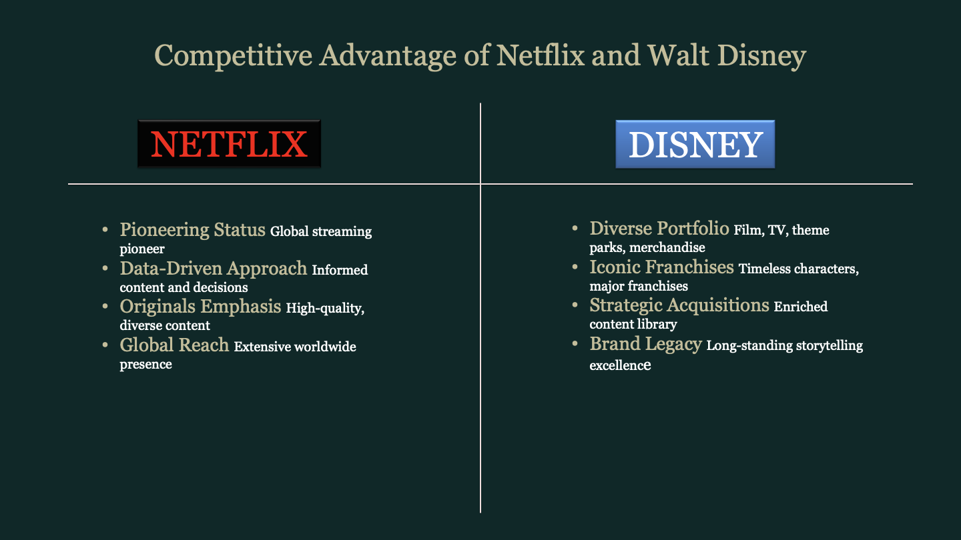

Slide 12
Financial Performance Analysis

Slide 13
Common Size of Balance Sheets and Cash Flow
NETFLIX
CONSOLIDATED BALANCE SHEETS - USD ($) $ in Thousands | Dec. 31, 2023 | Dec. 31, 2022 | Percentage Change
Current assets:
Cash and cash equivalents | 14.60% | 10.59% | 4.01%
Short-term investments | 0.04% | 1.88% | -1.83%
Other current assets | 5.71% | 6.60% | -0.90%
Total current assets | 20.35% | 19.07% | 1.28%
Content assets, net | 64.96% | 67.37% | -2.40%
Property and equipment, net | 3.06% | 2.88% | 0.18%
Other non-current assets | 11.62% | 10.69% | 0.94%
Total assets | 100.00% | 100.00% | 0.00%
Current liabilities:
Current content liabilities | 9.17% | 9.22% | -0.05%
Accounts payable | 1.53% | 1.38% | 0.15%
Accrued expenses and other liabilities | 3.70% | 3.12% | 0.58%
Deferred revenue | 2.96% | 2.60% | 0.36%
Short-term debt | 0.82% | 0.00% | 0.82%
Total current liabilities | 18.18% | 16.32% | 1.86%
Non-current content liabilities | 5.29% | 6.34% | -1.05%
Long-term debt | 29.02% | 29.54% | -0.51%
Other non-current liabilities | 5.26% | 5.05% | 0.21%
Total liabilities | 57.75% | 57.24% | 0.51%
Commitments and contingencies (Note 8)
Stockholders’ equity:
Preferred stock, $0.001 par value; 10,000,000 shares authorized at December 31, 2023 and December 31, 2022; no shares issued and outstanding at December 31, 2023 and December 31, 2022
Common stock, $0.001 par value; 4,990,000,000 shares authorized at December 31, 2023 and December 31, 2022; 432,759,584 and 445,346,776 issued and outstanding at December 31, 2023 and December 31, 2022, respectively | 10.56% | 9.54% | 1.01%
Treasury stock at cost (16,078,268 and 1,564,478 shares at December 31, 2023 and December 31, 2022) | -14.20% | -1.70% | -12.51%
Accumulated other comprehensive loss | -0.46% | -0.45% | -0.01%
Retained earnings | 46.35% | 35.36% | 11.00%
Total stockholders’ equity | 42.25% | 42.76% | -0.51%
Total liabilities and stockholders’ equity | 100.00% | 100.00% | 0.00%
CONSOLIDATED STATEMENTS OF CASH FLOWS - USD ($) $ in Thousands | 12 Months Ended
 | Dec. 31, 2023 | Dec. 31, 2022 | Dec. 31, 2021
Cash flows from operating activities:
Net income | $ 5,407,990 | $ 4,491,924 | $ 5,116,228
Adjustments to reconcile net income to net cash provided by operating activities:
Additions to content assets | -12,554,703 | -16,839,038 | -17,702,202
Change in content liabilities | -585,602 | 179,310 | 232,898
Amortization of content assets | 14,197,437 | 14,026,132 | 12,230,367
Depreciation and amortization of property, equipment and intangibles | 356,947 | 336,682 | 208,412
Stock-based compensation expense | 339,368 | 575,452 | 403,220
Foreign currency remeasurement loss (gain) on debt | 176,296 | -353,111 | -430,661
Other non-cash items | 512,075 | 533,543 | 376,777
Deferred income taxes | -459,359 | -166,550 | 199,548
Changes in operating assets and liabilities:
Other current assets | -181,003 | -353,834 | -369,681
Accounts payable | 93,502 | -158,543 | 145,115
Accrued expenses and other liabilities | 103,565 | -55,513 | 180,338
Deferred revenue | 178,708 | 27,356 | 91,350
Other non-current assets and liabilities | -310,920 | -217,553 | -289,099
Net cash provided by operating activities | 7,274,301 | 2,026,257 | 392,610
Cash flows from investing activities:
Purchases of property and equipment | -348,552 | -407,729 | -524,585
Change in other assets | 0 | 0 | -26,919
Acquisitions | 0 | -757,387 | -788,349
Purchases of short-term investments | -504,862 | -911,276 | 0
Proceeds from maturities of short-term investments | 1,395,165 | 0 | 0
Net cash provided by (used in) investing activities | 541,751 | -2,076,392 | -1,339,853
Cash flows from financing activities:
Repayments of debt | 0 | -700,000 | -500,000
Proceeds from issuance of common stock | 169,990 | 35,746 | 174,414
Repurchases of common stock | -6,045,347 | 0 | -600,022
Taxes paid related to net share settlement of equity awards | 0 | 0 | -224,168
Other financing activities | -75,446 | 0 | 0
Net cash used in financing activities | -5,950,803 | -664,254 | -1,149,776
Effect of exchange rate changes on cash, cash equivalents and restricted cash | 82,684 | -170,140 | -86,740
Net increase (decrease) in cash, cash equivalents and restricted cash | 1,947,933 | -884,529 | -2,183,759
Cash, cash equivalents and restricted cash, beginning of year | 5,170,582 | 6,055,111 | 8,238,870
Cash, cash equivalents and restricted cash, end of year | 7,118,515 | 5,170,582 | 6,055,111
Supplemental disclosure:
Income taxes paid | 1,154,973 | 811,720 | 509,265
Interest paid | $ 684,504 | $ 701,693 | $ 763,432

Slide 14
Common Size of Balance Sheets and Cash Flow
Walt Disney
CONSOLIDATED BALANCE SHEETS - USD ($) $ in Millions | Sep. 30, 2023 | Oct. 01, 2022 | Percentage Change
Current assets
Cash and cash equivalents | 6.90% | 5.70% | 1.19%
Receivables, net | 6.00% | 6.21% | -0.22%
Inventories | 0.95% | 0.86% | 0.10%
Content advances | 1.46% | 0.93% | 0.53%
Other current assets | 0.63% | 0.59% | 0.04%
Total current assets | 15.94% | 14.29% | 1.65%
Produced and licensed content costs | 16.34% | 17.57% | -1.23%
Investments | 1.50% | 1.58% | -0.08%
Attractions, buildings and equipment | 34.09% | 32.90% | 1.19%
Accumulated depreciation | -20.73% | -19.33% | -1.40%
Parks, resorts and other property, before projects in progress and land, Total | 13.37% | 13.57% | -0.21%
Projects in progress | 3.06% | 2.36% | 0.69%
Land | 0.57% | 0.56% | 0.01%
Parks, resorts and other property | 17.00% | 16.50% | 0.50%
Intangible assets, net | 6.35% | 7.29% | -0.93%
Goodwill | 37.49% | 38.25% | -0.77%
Other assets | 5.39% | 4.52% | 0.87%
Total assets | 100.00% | 100.00% | 0.00%
Current liabilities
Accounts payable and other accrued liabilities | 10.06% | 9.93% | 0.13%
Current portion of borrowings | 2.11% | 1.51% | 0.60%
Deferred revenue and other | 2.99% | 2.84% | 0.14%
Total current liabilities | 15.15% | 14.28% | 0.87%
Borrowings | 20.48% | 22.25% | -1.77%
Deferred income taxes | 3.53% | 4.11% | -0.58%
Other long-term liabilities | 5.87% | 6.15% | -0.28%
Commitments and contingencies
Redeemable noncontrolling interest | 4.40% | 4.66% | -0.26%
Equity
Preferred stock | 0.00% | 0.00% | 0.00%
Common stock, $0.01 par value, Authorized – 4.6 billion shares, Issued – 1.8 billion shares | 27.91% | 27.70% | 0.22%
Retained earnings | 22.42% | 21.43% | 0.99%
Accumulated other comprehensive loss | -1.60% | -2.02% | 0.42%
Treasury stock, at cost, 19 million shares | -0.44% | -0.45% | 0.00%
Total Disney Shareholders’ equity | 48.29% | 46.66% | 1.63%
Noncontrolling interests | 2.28% | 1.90% | 0.38%
Total equity | 50.57% | 48.56% | 2.01%
Total liabilities and equity | 100.00% | 100.00% | 0.00%
CONSOLIDATED STATEMENTS OF CASH FLOWS - USD ($) $ in Millions | 12 Months Ended
 | Sep. 30, 2023 | Oct. 01, 2022 | Oct. 02, 2021
Net income from continuing operations | $ 3,390 | $ 3,553 | $ 2,536
OPERATING ACTIVITIES
Depreciation and amortization | 5,369 | 5,163 | 5,111
Impairments of produced and licensed content costs and goodwill | 2,987 | 0 | 0
Net (gain)/loss on investments | -166 | 714 | -332
Deferred income taxes | -1,346 | 200 | -1,241
Equity in the income of investees | -782 | -816 | -761
Cash distributions received from equity investees | 720 | 779 | 754
Net change in produced and licensed content costs and advances | -1,908 | -6,271 | -4,301
Equity-based compensation | 1,143 | 977 | 600
Pension and Postretirement Medical Amortization | 4 | 620 | 816
Other, net | 278 | 595 | 190
Changes in operating assets and liabilities
Receivables | 358 | 605 | -357
Inventories | -183 | -420 | 252
Other assets | -201 | -707 | 171
Accounts payable and other liabilities | -1,142 | 964 | 2,410
Income taxes | 1,345 | 46 | -282
Cash provided by operations - continuing operations | 9,866 | 6,002 | 5,566
INVESTING ACTIVITIES
Investments in parks, resorts and other property | -4,969 | -4,943 | -3,578
Proceeds from sales of investments | 458 | 52 | 337
Other, net | -130 | -117 | 70
Cash used in investing activities - continuing operations | -4,641 | -5,008 | -3,171
FINANCING ACTIVITIES
Commercial paper payments, net | -191 | -334 | -26
Borrowings | 83 | 333 | 64
Reduction of borrowings | -1,675 | -4,016 | -3,737
Proceeds from exercise of stock options | 52 | 127 | 435
Contributions from / sales of noncontrolling interests | 735 | 74 | 91
Acquisition of redeemable noncontrolling interests | -900 | 0 | -350
Other, net | -828 | -913 | -862
Cash provided by (used in) financing activities - continuing operations | -2,724 | -4,729 | -4,385
CASH FLOWS FROM DISCONTINUED OPERATIONS
Cash provided by operations - discontinued operations | 0 | 8 | 1
Cash provided by investing activities - discontinued operations | 0 | 0 | 8
Cash used in financing activities - discontinued operations | 0 | -12 | 0
Cash (used in) provided by discontinued operations | 0 | -4 | 9
Effect of Exchange Rate on Cash, Cash Equivalents, Restricted Cash, and Restricted Cash Equivalents, Including Disposal Group and Discontinued Operations | 73 | -603 | 30
Change in Cash, Cash Equivalents and Restricted Cash | 2,574 | -4,342 | -1,951
Cash, cash equivalents and restricted cash, beginning of year | 11,661 | 16,003 | 17,954
Cash, cash equivalents and restricted cash, end of year | 14,235 | 11,661 | 16,003
Supplemental disclosure of cash flow information:
Interest paid | 2,110 | 1,685 | 1,892
Income taxes paid | $ 1,193 | $ 1,097 | $ 1,638

Slide 15
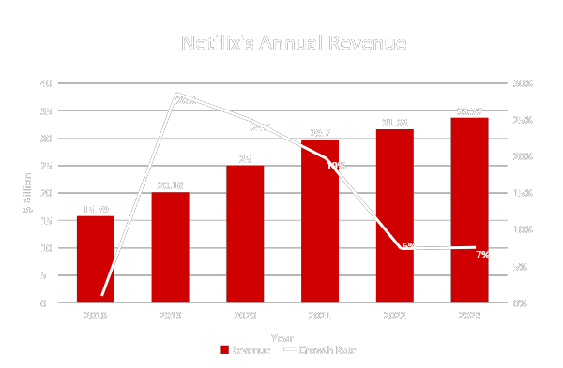
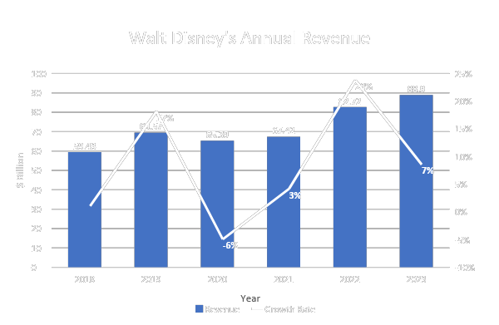
NETFLIX VS. Walt Disney
Revenue
Netflix: Revenue increases continuously, little bit slow in these two years.
Walt Disney: Revenue decreased in 2020, and then increased again. Market Share is doubled as Netflix.

Slide 16
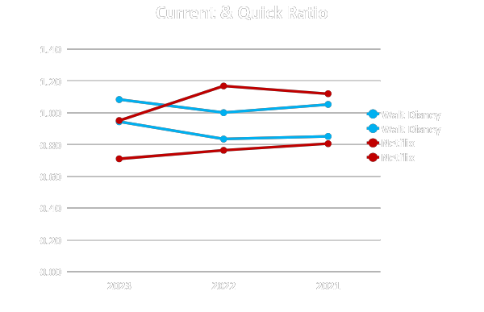
NETFLIX VS. Walt Disney
Liquidity
Netflix
 | 2023 | 2022 | 2021
Current Ratio | 1.12 | 1.17 | 0.95
Quick Ratio | 0.81 | 0.76 | 0.71
CCC | -8.09 | -7.75 | -10.29
Walt Disney
 | 2023 | 2022 | 2021
Current Ratio | 1.05 | 1.00 | 1.08
Quick Ratio | 0.85 | 0.83 | 0.94
CCC | -22.14 | -21.67 | 2.19
In general, good liquidity of both
The gap between current ratio and quick ratio
of Netflix is higher

Slide 17
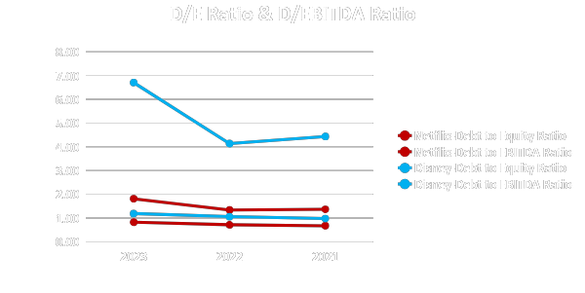
NETFLIX VS. Walt Disney
Leverage
Netflix
 | 2023 | 2022 | 2021
Debt to Equity Ratio | 1.37 | 1.34 | 1.81
Debt to EBITDA Ratio | 0.68 | 0.72 | 0.83
Walt Disney
 | 2023 | 2022 | 2021
Debt to Equity Ratio | 0.98 | 1.06 | 1.19
Debt to EBITDA Ratio | 4.44 | 4.14 | 6.70
Both of the two companies add leverage to use the capital.
Walt Disney’s Debt to EBITDA Ratio is high, a big concern of investors. The high ratio caused the high risk of its ability to manage the debt.

Slide 18
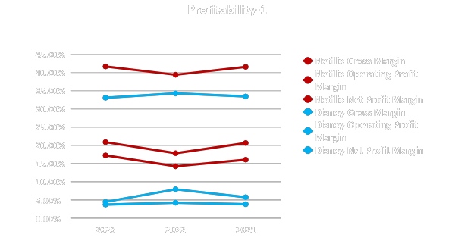
NETFLIX VS. Walt Disney
Profitability-1
Netflix
 | 2023 | 2022 | 2021
Gross Margin | 41.54% | 39.37% | 41.64%
Net Operating Profit Margin | 20.62% | 17.82% | 20.86%
Net Profit Margin | 16.04% | 14.21% | 17.23%
Walt Disney
 | 2023 | 2022 | 2021
Gross Margin | 33.41% | 34.24% | 33.06%
Net Operating Profit Margin | 5.74% | 7.90% | 4.46%
Net Profit Margin | 3.81% | 4.24% | 3.72%
In Gross Margin, Net Operating Profit Margin and Net Profit Margin, Netflix’s profitability is much higher than Walt Disney.
Focus on the Operating Profit Margin, too high cost of core business of Disney.

Slide 19
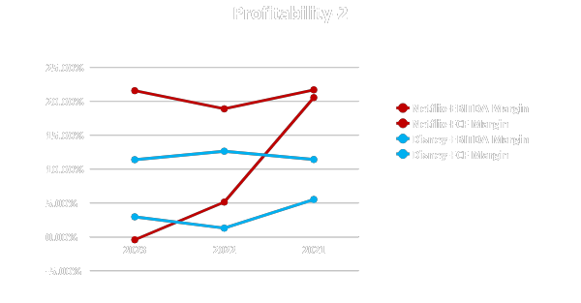
NETFLIX VS. Walt Disney
Profitability-2
Netflix
 | 2023 | 2022 | 2021
EBITDA Margin | 21.68% | 18.88% | 21.56%
FCF Margin | 20.54% | 5.12% | -0.44%
Walt Disney
 | 2023 | 2022 | 2021
EBITDA Margin | 11.78% | 12.63% | 11.38%
FCF Margin | 5.51% | 1.28% | 2.95%
Both of the EBITDA Margin and FCF Margin of Netflix
are higher than Walt Disney, except the only one in 2021.
Disney has problems in operating income.

Slide 20
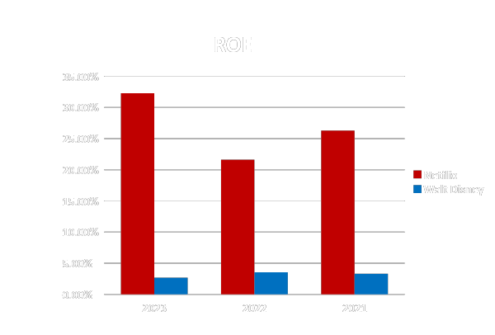
NETFLIX VS. Walt Disney
ROE
ROE(Return Of Equity)
 | 2023 | 2022 | 2021
Netflix | 26.27% | 21.62% | 32.28%
Walt Disney | 3.30% | 3.54% | 2.70%
For the stockholders and investors, Netflix’s ROE is much higher than Walt Disney in the past 3 Years.

Slide 21

Financial Performance Analysis
10/12Golden Stars (WD has 4 )
Continuous Revenue Increase in the last 5 years-Stable development-Better future anticipation
Good Liquidity Condition
Lower Leverage Ratio-Lower Risk for Investors
Higher Profitability Ratio-Better Operation-Better return to investors
The ROE is much higher-IMPORTANT for stockholders and investors

Slide 22
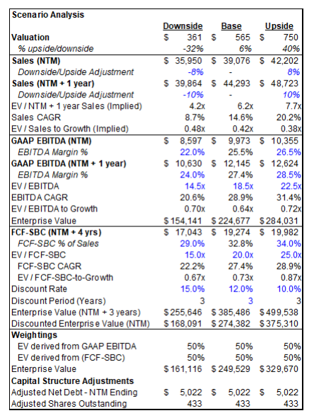
Valuation DCF Model | 2024 | 2025 | 2026 | 2027 | 2028
Operating Income | 7,192,231 | 7,721,223 | 8,300,080 | 8,991,875 | 9,676,862
Depreciation and Amortization | 499,726 | 699,616 | 979,463 | 1,371,248 | 1,919,747
CapEx | -406,365 | -406,365 | -406,365 | -406,365 | -406,365
FCFF | 7,285,592 | 8,014,474 | 8,873,178 | 9,956,757 | 11,190,244
WACC | 10% | 10% | 10% | 10% | 10%
FCFF YOY |  | 10% | 11% | 12% | 12%
PV | 7285592 | 7352729 | 7468376 | 7688444 | 7927451
TV2028 |  |  |  |  | 526,559,071
PV2024 | 373,027,721 |  | Equity | 382,889,286
SUM | 410,750,313 |  | Stock Price | 878.3415567
No. of Outstanding Shares | 435,923
Debt | $ 27,861,027

Slide 23
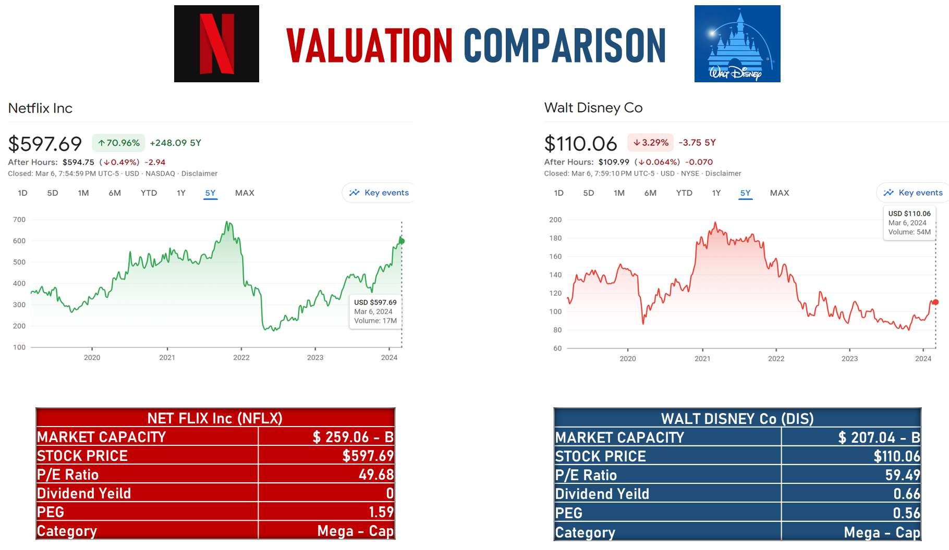

Slide 24
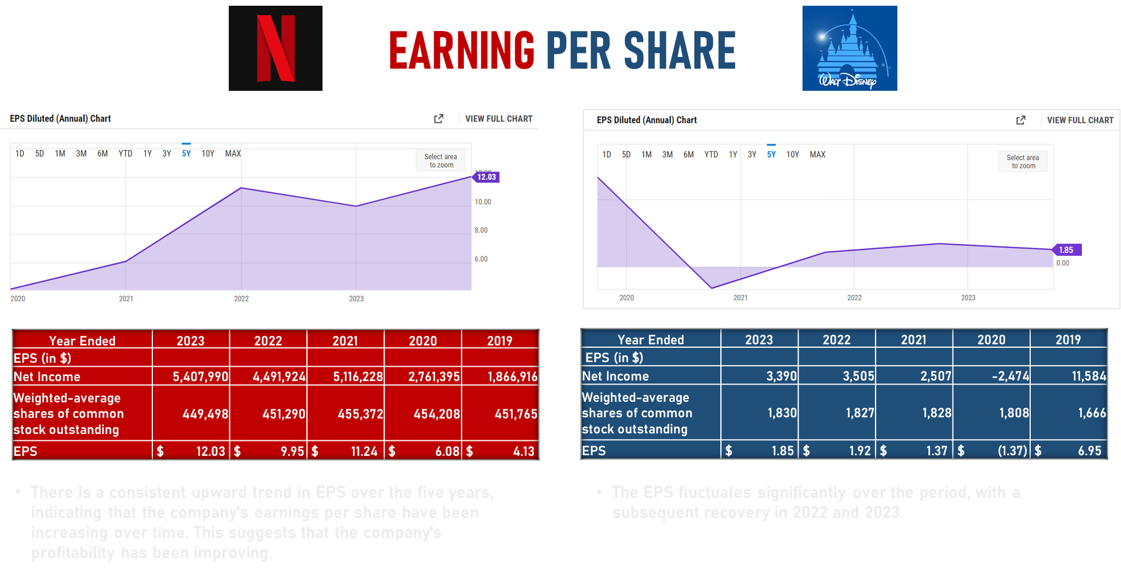

Slide 25
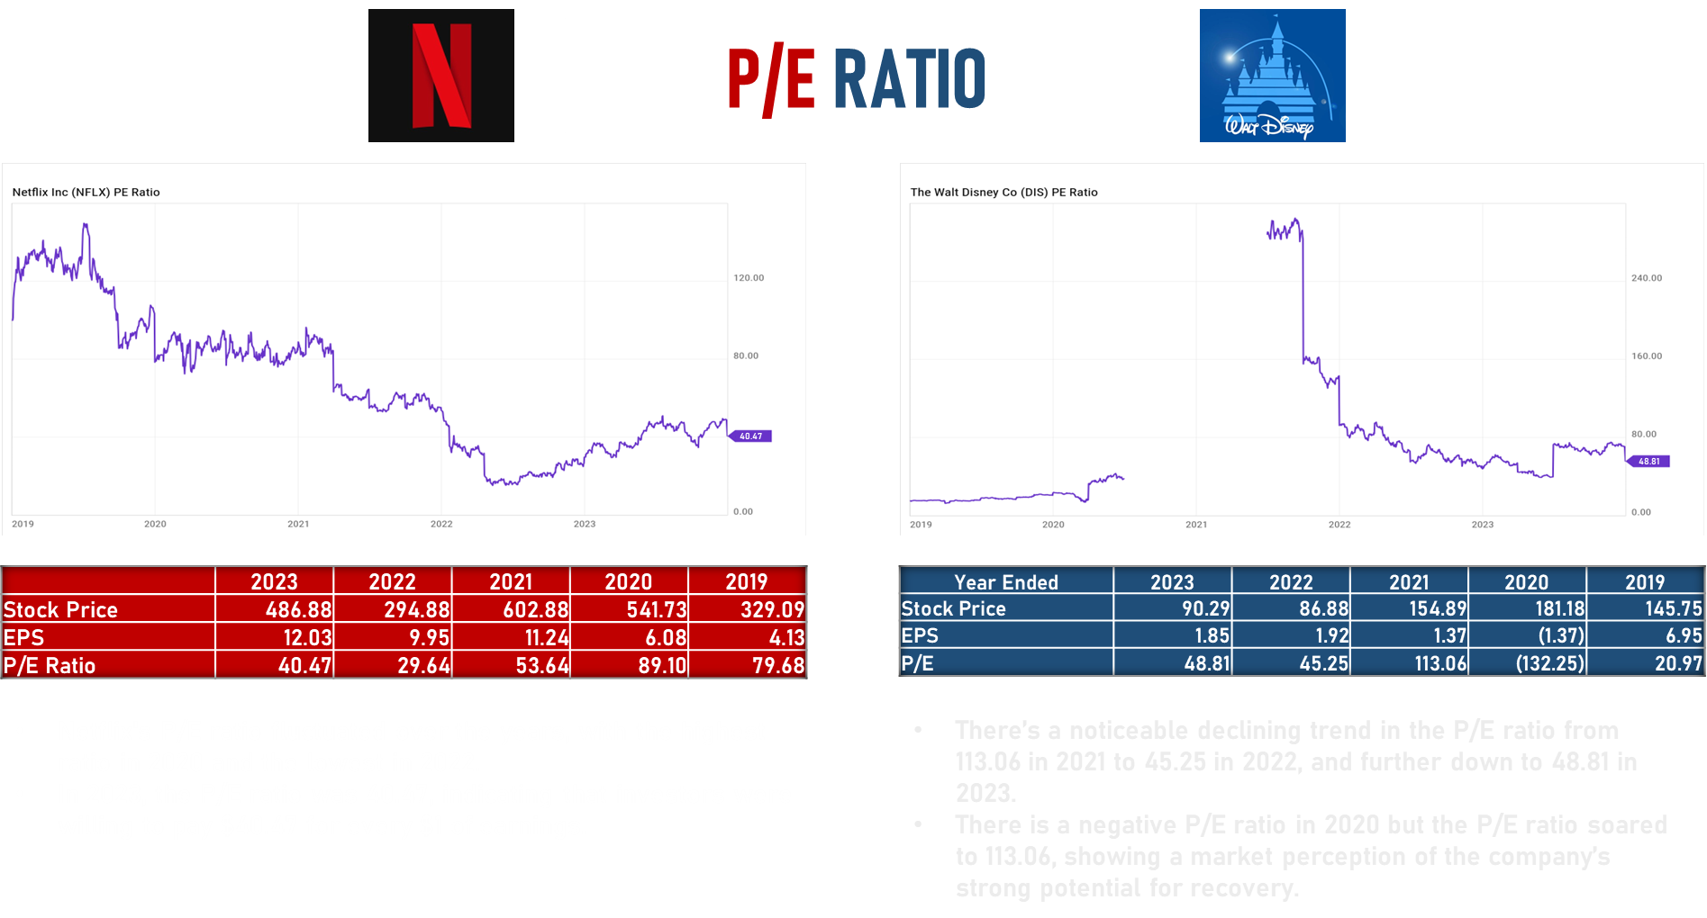

Slide 26
Netflix:
Increased cash and cash equivalents signify improved liquidity and financial resilience.
Decrease in short-term investments raises questions about investment strategy.
Reduction in non-current content liabilities indicates positive developments in managing long-term obligations.
Rise in common stock issuance may indicate capital-raising efforts.
Substantial increase in treasury stock raises concerns about potential dilution and impact on shareholder value.

Slide 27
Disney:
Slight increase in current assets driven by higher cash reserves, receivables, and content advances.
Concerning trends in declining investments and increasing borrowings.
Decrease in net income from continuing operations and significant rise in depreciation and amortization expenses.
Improved operating cash flow, but challenges remain in reducing borrowings.
Focus needed on managing asset-liability mix, controlling costs, and optimizing cash flow amidst market dynamics.

Slide 28
Recommendations:
Monitor cash management closely.
Evaluate debt structures for both companies.
Assess implications of equity transactions on shareholder value.
Optimize resource allocation to align with long-term growth objectives.

